Slide 1

A Comparative Study On Skin Cancer Detection using Transfer Learning Models and CNN
by
M.Ravi Teja
Roll No. 184G1A0564
Shaik Umme Honey
Roll No. 184G1A05A7
K.Swathi
Roll No. 184G1A05A3
Under the guidance of
Mr. Sreedhar Boya _{M.Tech,MBA}
Assistant Professor
Department of Computer Science and Engineering
Srinivasa Ramanujan Institute of Technology
(Affiliated to JNTUA & Approved by AICTE) (Accredited by NAAC with ‘A’ Grade & Accredited by NBA (EEE, ECE & CSE)
Rotarypuram Village, B K Samudram Mandal, Ananthapuramu – 515701.
2021 - 2022

Slide 2

Contents
Introduction
Existing System
Proposed System
Literature Survey
Problem Definition
Requirements
UML Diagram
Data Flow Diagram
Sample Code
screenshots
Conclusion
References

Slide 3
Introduction
Skin types of diseases are most common among the globe, as people get skin disease due to inheritance, environmental factors. In many cases people ignore the impact of skin disease at the early stage.
If diagnosed in later stages. However, if the skin disease is detected at early stages then the survival rate is nearly 97% in order to prevent from cancer.
It is found that a skilled dermatologist usually follows a series of steps:
starting with naked eye observation of suspected lesions,
dermoscopy (magnifying lesions microscopically) and followed by biopsy. This would consume time and the patient may advance to later stages.

Slide 4
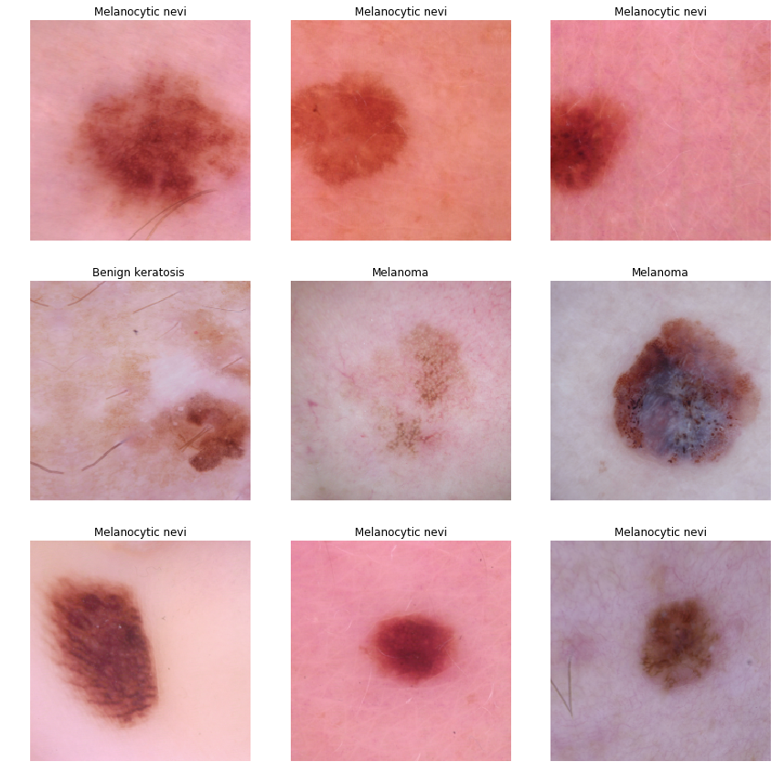
Reference images for Disease Detection

Slide 5
Contd...
In such process, the accuracy of diagnostics is not always acceptable and involves some errors.
Therefore, high performance computer aided diagnostic systems help the physicians to avoid misdiagnosis.
The common approaches to skin lesion early detection include different steps:
Preprocessing, Segmentation, Feature extraction and Classification
The output of each step is the input of next step, all steps have an important role to avoid misdiagnosis.

Slide 6
Existing System
This model emphasizes an existing method that which is designed using the some of the algorithms of deep learning.
Here the process is performed using the ANN methods, which is one of the Machine Learning methods, but this could not get the high accuracy.

Slide 7
Proposed System
In proposed method we are performing the classification of either the Skin Disease identification using Convolution Neural Network (CNN) of deep learning along with the transfer learning methods. As image analysis based approaches for skin disease classification.
Hence, proper classification is important for the proper nutrition that which will be possible by using our proposed method.

Slide 8
Literature Survey
[1](Srividhya, Sujatha, Ponmagal, Durgadevi, Madheshwaran, et al., 2020)Machine learning based on the high-performance image is used to detect skin cancer that achieved good efficiency in identification. However, the accuracy of the model can be increased by extracting more features and sensitivity is more deviated.
[2]In (Hoshyar, Al-Jumaily, & Hoshyar, 2014) the author proposed a method using image processing steps that helps to increase the detection accuracy of skin cancer. However, they could not narrate a specific model that can efficiently detect cancer.

Slide 9
Contd....
[3] Nawal Soliman ALKolifi ALEnezi, This work contributes in the research of skin disease detection. We proposed an image processing-based method to detect skin diseases. This method takes the digital image of disease effect skin area, then use image analysis to identify the type of disease. Our proposed approach is simple, fast and does not require expensive equipment other than a camera and a computer(ALEXNET).
[4] Li-sheng Wei , Quan Gan, and Tao Ji, the method of grey-level co-occurrence matrix (GLCM) was introduced to segment images of skin disease. The texture and color features of diﬀerent skin disease images could be obtained accurately. Finally, by using the support vector machine (SVM) classiﬁcation method, three types of skin diseases were identiﬁed. The experimental results demonstrate the eﬀectiveness and feasibility of the proposed method.

Slide 10
Problem Definition
Skin Diseases are ranked fourth most common cause of human illness, but many still do not consult doctors.
We presented a robust and automated method for the diagnosis of dermatological diseases.
Treatments for skin are more effective and less disfiguring when found early. We should point out that it is to replace doctors because no machine can yet replace the human input on analysis and intuition.
So we are using Resnet and Xception algorithms for evaluating the accuracy.
Moreover we are going to compare the both models with ensembling methods of Resnet and other transfer learning methods for high accuracy.

Slide 11
Requirements
SYSTEM SPECIFICATIONS:
H/W Specifications:
Processor : I5/Intel Processor
RAM : 8GB (min)
Hard Disk : 128 GB
S/W Specifications:
Operating System : Windows 10
Server-side Script : Python 3.6
IDE : Visual Studio Code
Libraries Used : Numpy, Flask, keras, pandas, tensorflow,Skicit learn,

Slide 12
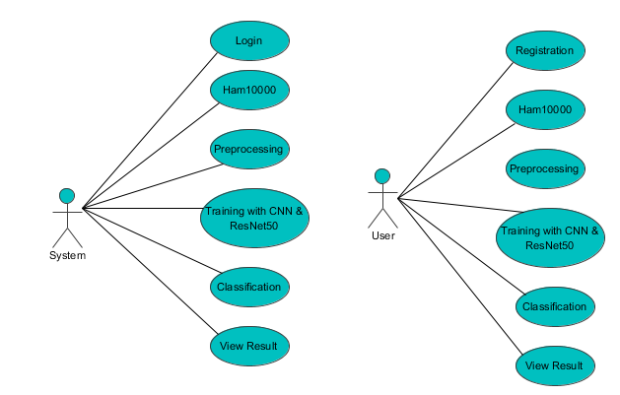
UML Diagram
Use Case Diagram

Slide 13
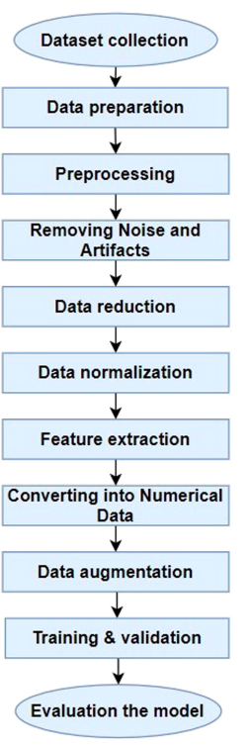
DataFlow Diagram

Slide 14
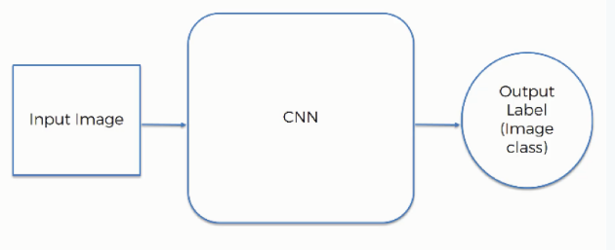
Implementation
1. Convolutional neural network (CNN):
A convolutional neural network consists of an input layer, hidden layers and an output layer. In any feed-forward neural network, any middle layers are called hidden because their inputs and outputs are masked by the activation function and final convolution.

Slide 15
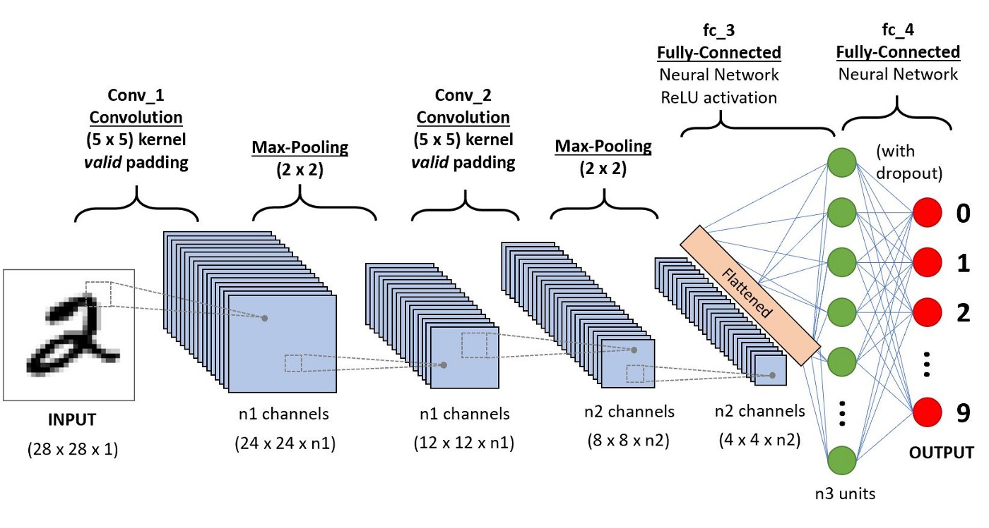
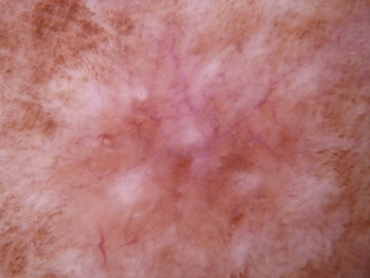
Contd…
CNN sequence

Slide 16
Sample code
^{model = Sequential()}
model.add(Conv2D(filters = 32, kernel_size = (5,5),padding = 'Same',
activation ='relu', input_shape = (128,128,3)))
model.add(Conv2D(filters = 32, kernel_size = (5,5),padding = 'Same',
^{activation ='relu'))}
model.add(MaxPool2D(pool_size=(2,2)))
^{model.add(Flatten())}
model.add(Dense(256, activation = "relu"))
model.add(Dense(num_classes, activation = "softmax"))
^{model.summary()}

Slide 17
ResNet50
ResNet50 is a convolutional neural network which has a depth of 50 layers. It was build and trained by Kaiming He, Xiangyu Zhang, Shaoqing Ren, and Jian Sun in their 2015 .
you can access the model performance results on their paper, titled Deep Residual Learning for Image Recognition.
This model is also trained on more than 1 million images from the ImageNet database. Just like VGG-19, it can classify up to 1000 objects and the network was trained on 224x224 pixels colored images. Here is brief info about its size and performance:

Slide 18
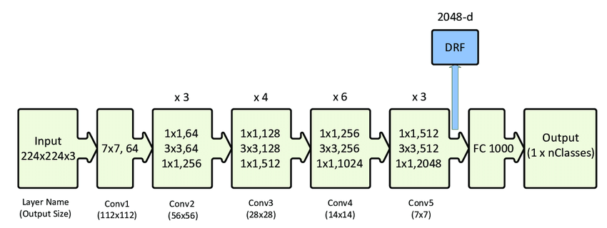
Contd…

Slide 19
Sample code
def ResNet50(input_shape=(128, 128, 3),classes=7):
X_input = Input(input_shape)
X = ZeroPadding2D((3, 3))(X_input)
X = Conv2D(64, (7, 7), strides=(2, 2))(X)
X = BatchNormalization(axis=3)(X)
X = Activation('relu')(X)
X = MaxPooling2D((3, 3), strides=(2, 2))(X)

Slide 20
Xception
Xception is a deep convolutional neural network architecture that involves Depth wise Separable Convolutions.
This observation leads them to propose a novel deep convolutional neural network architecture inspired by Inception, where Inception modules have been replaced with depth wise separable convolutions.
Xception is a deep convolutional neural network architecture that involves Depth wise Separable Convolutions. It was developed by Google researchers.

Slide 21
Contd...
Google presented an interpretation of Inception modules in convolutional neural networks as being an intermediate step in-between regular convolution and the depth wise separable convolution operation (a depth wise convolution followed by a point wise convolution).
In this light, a depth wise separable convolution can be understood as an Inception module with a maximally large number of towers.
This observation leads them to propose a novel deep convolutional neural network architecture inspired by Inception, where Inception modules have been replaced with depth wise separable convolutions.

Slide 22
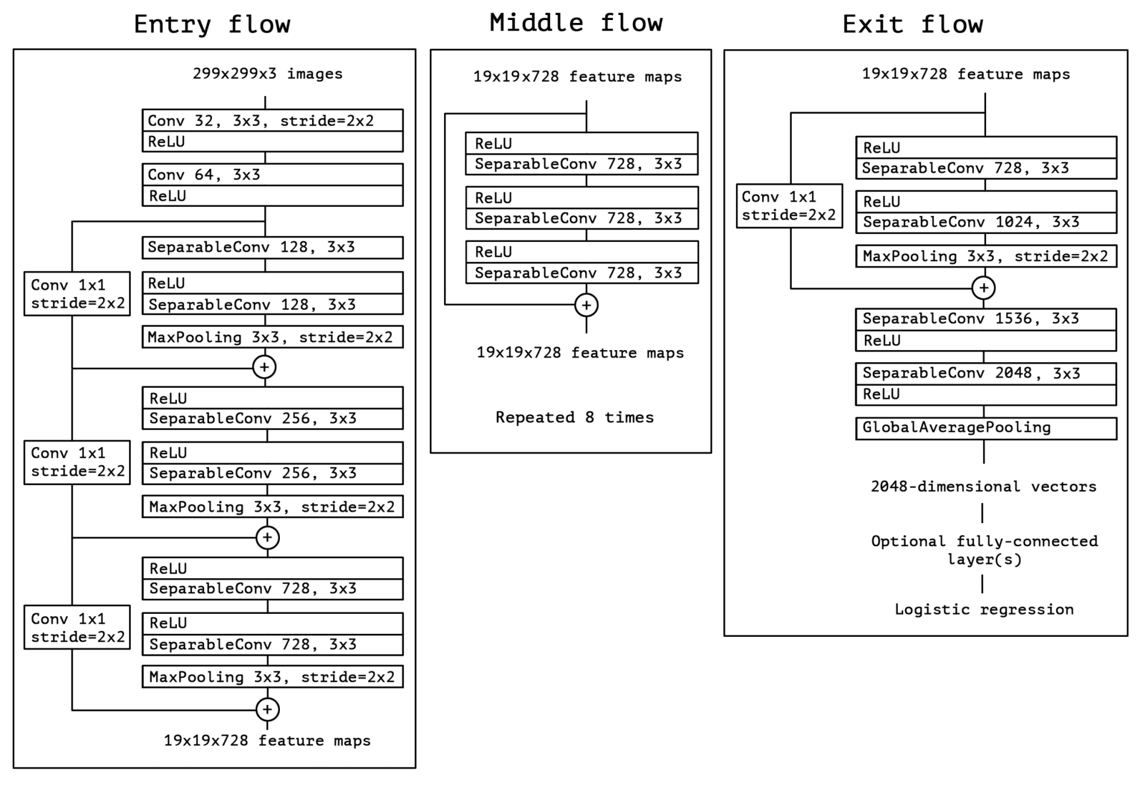
Block diagram

Slide 23
Sample code for xception
input = Input(shape = (299,299,3))
x = entry_flow(input)
x = middle_flow(x)
output = exit_flow(x)
model = Model (inputs=input, outputs=output)
model.summary()

Slide 24
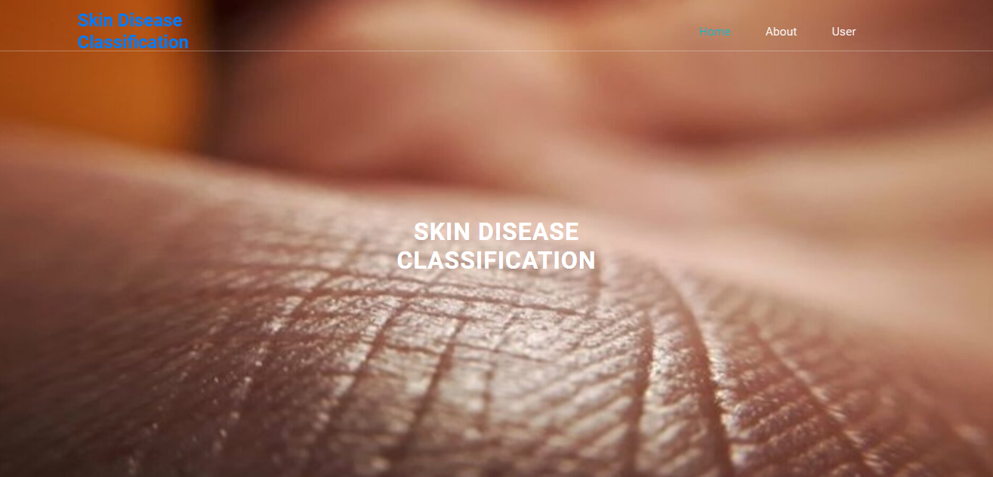
Output Screenshots
Home: In our project, we are classifying the presence of Skin Disease Classification, with the help of CNN and Transfer learning.

Slide 25
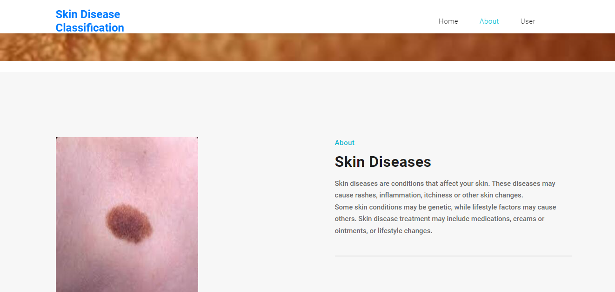
Contd...
About Project: Here the user will get a breif idea about the project.

Slide 26
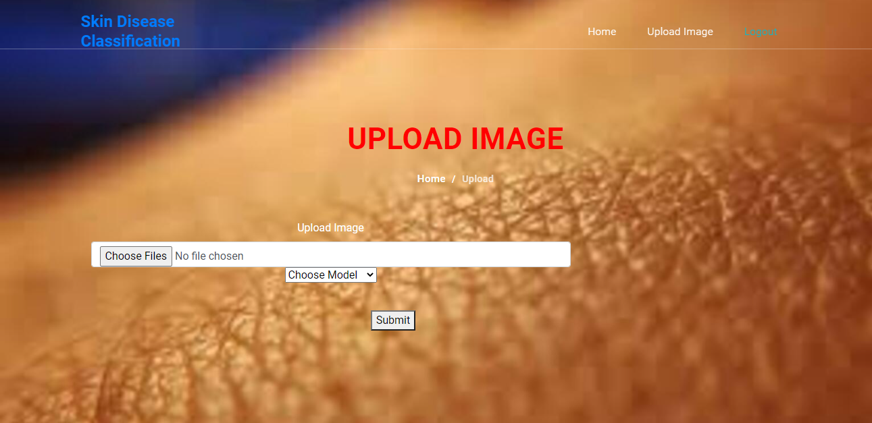
Contd...
Image Upload Page

Slide 27
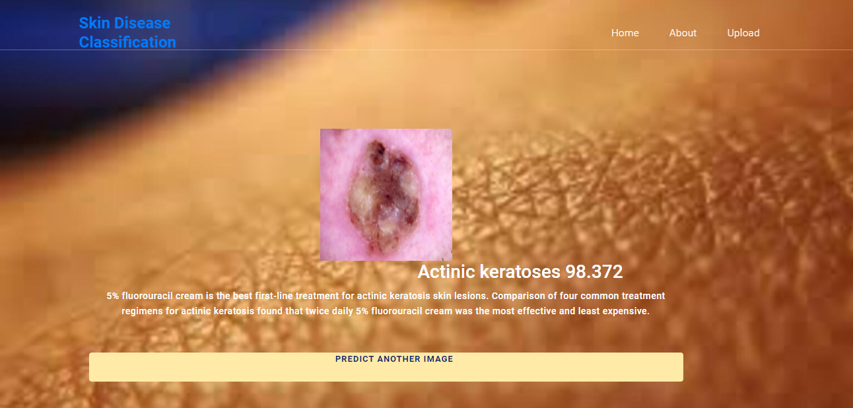
Contd...
Actinic Keratoses

Slide 28
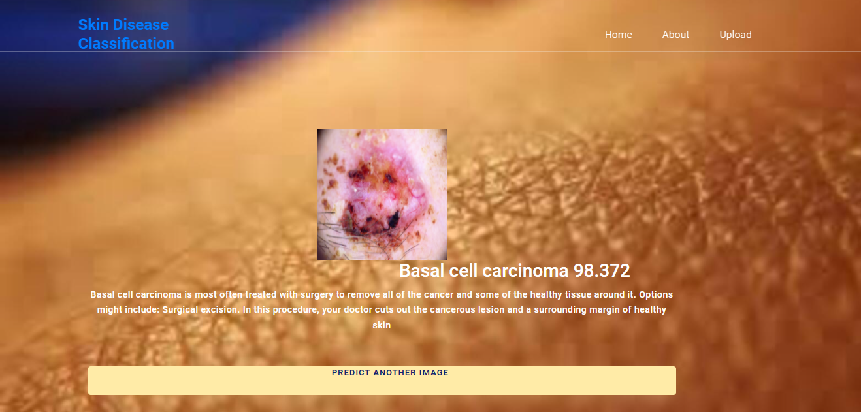
Basal cell carcinoma

Slide 29
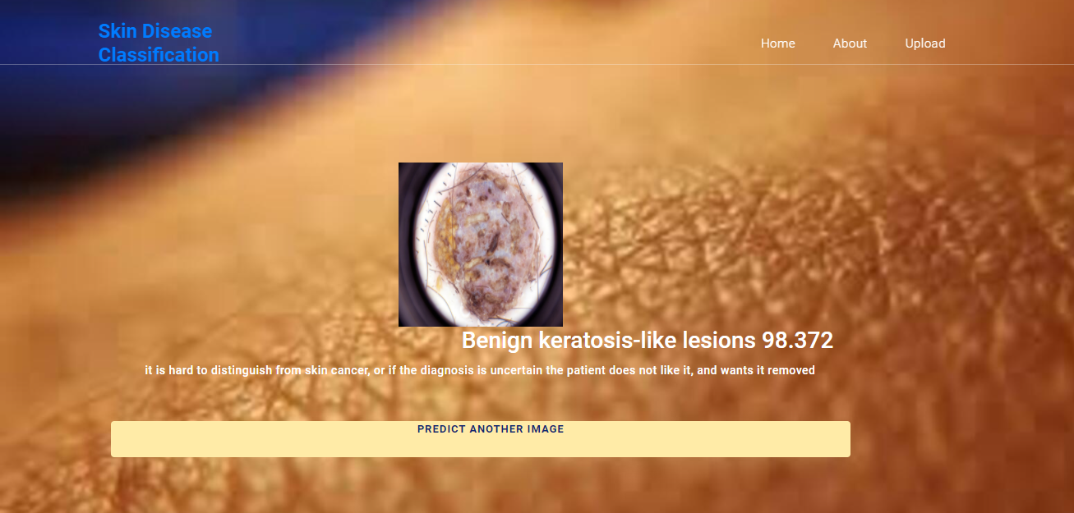
Contd..
Benign keratosis-like lesions

Slide 30
Conclusion
In this project we have successfully classified the images of Identification of Skin Diseases, are affected with the using the deep learning and Transfer learning.
Here, we have considered the dataset of ham10000 images which will be of different types Diseases and trained using CNN along with some ResNet50 and Xception transfer learning method. After the training we have tested by uploading the image and classified it.

Slide 31
Future Scope
This can be utilized in future to classify the types of different Diseases to prevent the Precautions to the patients.
Motivation
To develop a solution that can help dermatologists better support their diagnostic accuracy by ensembling contextual images and patient-level information, reducing the variance of predictions from the model.

Slide 32
Base Paper Reference
[1]. Srividhya, Sujatha, Ponmagal, Durgadevi, Madheshwaran, “Detection and Categorization of Skin lesions using deep learning neural networks” ScienceDirect where the paper published, Procedia Computer Science 171 (2020) 1726–1735
[2]. Hoshyar, Al-Jumaily, & Hoshyar, “The Beneficial Techniques in Preprocessing Step of Skin Cancer”,ScienceDirect where the paper published , Procedia Computer Science 42 ( 2014 ) 25 – 31
[3]. Kadampur & Al Riyaee, “Skin cancer detection: Applying a deep learning based model driven”,ScienceDirect where the paper published,2020
[4]. Nawal Soliman ALKolifi ALEnezi, “A Method Of Skin Disease Detection Using Image Processing And Machine Learning”, ScienceDirect where the paper published,2020
[5]. Li-sheng Wei , Quan Gan, and Tao Ji, “Skin Disease Recognition Method Based on Image Color and Texture Features”,Research article at Hindawi.pubished in 2018

Slide 33
Thank You!!!

